Slide 1
Wikipedia Entry Augmentation by Enriching Source Data Set Using a Multi-lingual Ontology Based Framework
Presented by
Md. Tasnim Manzur Ankon (1015052071)
Supervised by
Dr. Muhammad Masroor Ali
Department of Computer Science and Engineering
Bangladesh University of Engineering and Technology

Slide 2
Acknowledgements
All the appraisals belong to the Almighty ALLAH
Gratitude to my respected supervisor
Gratitude to my parents and other family members

Slide 3


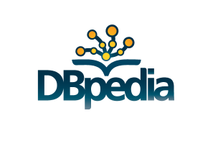
Overview
Semantic Web
A technique to evolve traditional web
Ontology
A formal description technique to structure information
Wikipedia and DBpedia
Web encyclopedia for humans and computers

Slide 4
Abstract
Enhancement of the traditional web
Multilingual
Improved source data set
Introduction to a framework
Addition of new languages
Addition of new data to existing sources
Improve extraction technique
Concentrate multiple data sources into one
Experimental proof of augmentation

Slide 5
Introduction
Wikipedia Entry Augmentation
Knowledge content in traditional web
Complexity faced by innumerable systems
Innumerable formats of web content
Solution: Semantic Web

Slide 6
Introduction (continued)
Semantic Web introduces: Ontology [5]-[7]
Describe and represent concepts
Relations among concepts
Can target a specific domain
Can share knowledge about the specific domain
Machine-readable format
Additional requirement: Integration of multiple languages [8]
Solution proposed: Develop individual ontologies for each language [8]

Slide 7
Introduction (continued)
Requirements:
Structured definition of entities
Need of a concrete source
Wikipedia and DBpedia [9]
Wikipedia and DBpedia
Human readable and machine readable
Property-statement pair based description [5]
[5] L. Yu, A developer’s guide to the semantic Web. Springer Science & Business Media, 2011.
[6] P. Hitzler, M. Krotzsch, and S. Rudolph, Foundations of semantic web technologies. CRC Press, 2009.
[7] G. Antoniou and F. Van Harmelen, A semantic web primer. MIT press, 2004.

Slide 8
Introduction (continued)
A little more on DBpedia
URI based unique identifiers [9]
Versions in different languages
Ontology: multilingual in nature [10]
Ontology
Mapped entities from all available languages [8]
Eligible to adapt new languages [11]
[8] C. T. dos Santos, P. Quaresma, and R. Vieira, “A framework for multilingual ontology mapping,” in Proceedings of the International Conference on Language Resources and Evaluation, LREC, ACM, 2008.
[9] J. Lehmann, R. Isele, M. Jakob, A. Jentzsch, D. Kontokostas, P. N. Mendes, S. Hellmann, M. Morsey, P. van Kleef, S. Auer, et al., “DBpedia–a large-scale, multilingual knowledge base extracted from Wikipedia,” Semantic Web, vol. 6, no. 2, pp. 167–195, 2015.
[10] J. Guyot, S. Radhouani, and G. Falquet, “Ontology-based multilingual information retrieval.,” in CLEF (Working Notes), 2005.
[11] M. T. M. Ankon, S. N. Tumpa, and M. M. Ali, “A multilingual ontology based framework for wikipedia entry augmentation,” in Computer and Information Technology (ICCIT), 2016 19th International Conference on, pp. 541–545, IEEE, 2016.

Slide 9
Introduction (continued)
Purposes of Ontology
Map exact definition and description [12]
Description: concept of the source that acts as data repository
Better data set -> efficient ontology [13, 14]
Issue: Immense amount of unstructured data [15]
Solution
A framework with well-defined structures
Guidelines to make information machine readable [8, 11]
[12] F. Giunchiglia, M. Yatskevich, P. Avesani, and P. Shvaiko, “A large scale dataset for the evaluation of ontology matching systems,” tech. rep., University of Trento, 2008.
[13] J. Euzenat, C. Meilicke, H. Stuckenschmidt, P. Shvaiko, and C. Trojahn, “Ontology alignment evaluation initiative: six years of experience,” in Journal on data semantics XV, pp. 158–192, Springer, 2011.
[14] G. Rizzo, Knowledge extraction from unstructured data and classification through distributed ontologies. PhD thesis, Politecnico di Torino, 2012.
[15] M. Manuja and D. Garg, “Semantic web mining of un-structured data: challenges and opportunities,” International Journal of Engineering (IJE), vol. 5, no. 3, p. 268, 2011.

Slide 10
Introduction (continued)
Focus of our research
Establish a framework [11]
Prepares subject-property-statement triples
Integrates to the understanding of multilingual ontology
Establish a system [16]
Based on the proposed framework
Combine the knowledge bases of multiple languages
Create a rich and enhanced data source
Additional contributions
Better way to add new languages to DBpedia
Augment Wikipedia
Demonstration of the magnitude of enhancement
[11] M. T. M. Ankon, S. N. Tumpa, and M. M. Ali, “A multilingual ontology based framework for wikipedia entry augmentation,” in Computer and Information Technology (ICCIT), 2016 19th International Conference on, pp. 541–545, IEEE, 2016.
[16] M. T. M. Ankon and M. M. Ali, “Wikipedia entry augmentation by sub-merging entities based on multilingual ontology,” in Informatics, Electronics and Vision & 2017 7th International Symposium in Computational Medical and Health Technology (ICIEV-ISCMHT), 2017 6th International Conference on, pp. 1–6, IEEE, 2017.
Notes:
Major focus

Slide 11
Objectives
Hypothesizing a framework for the multilingual ontology.
Establish a generalized system that can create language independent data sets, aligned with the framework proposed for multilingual ontology.
Generate single, rich and extract worthy data set by ensuring the best of quality through the formulation and implementation of a set of semantic rules.
Augment Wikipedia entries with the help of the generated data sets
Notes:
Major focus: Only elaborate what we are targeting to do

Slide 12
Summary of Contributions
A framework that is able to handle adaptations due to update of existing resources and addition of new language to the existing multilingual ontology.
A web based system that can prepare a rich and efficient data set by merging resources from the resources of two languages.
A set of semantic rules that ensures that the generated data set are of highest efficiency.
The passive motive of giving a strong base to any new language that is to be brought under the domain of the multilingual ontology.
Notes:
No need to elaborate much. Just state the title what will be done.

Slide 13
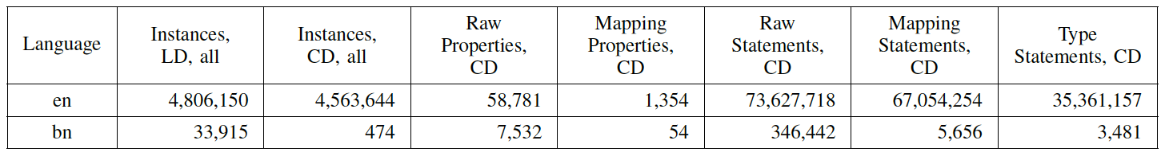
Current Status
Present statistics
Cross language linking between similar entities [19]
English “Rice” with Bengali “চাল”
Localized and canonicalized data sets
Extent of mapping between English and Bengali entities
[19] Wikipedia, “Rice — Wikipedia, the free encyclopedia.” http://en.wikipedia.org/w/index.php?title=Rice&oldid=723842664, 2016. [Online; accessed 18-June-2017].
Notes:
The table contains data for DBpedia entities which are mapped with Wikipedia entities.

Slide 14
Current Status (continued)
Mapping of multiple languages
Similar example of English “Rice” with Bengali “চাল”
Translation
Dictionaries acting as data sets
Direct translation from English to any other language
Extend mapping with reference to English
Loss of the required structured formatting [9]
[9] J. Lehmann, R. Isele, M. Jakob, A. Jentzsch, D. Kontokostas, P. N. Mendes, S. Hellmann, M. Morsey, P. van Kleef, S. Auer, et al., “DBpedia–a large-scale, multilingual knowledge base extracted from Wikipedia,” Semantic Web, vol. 6, no. 2, pp. 167–195, 2015.

Slide 15
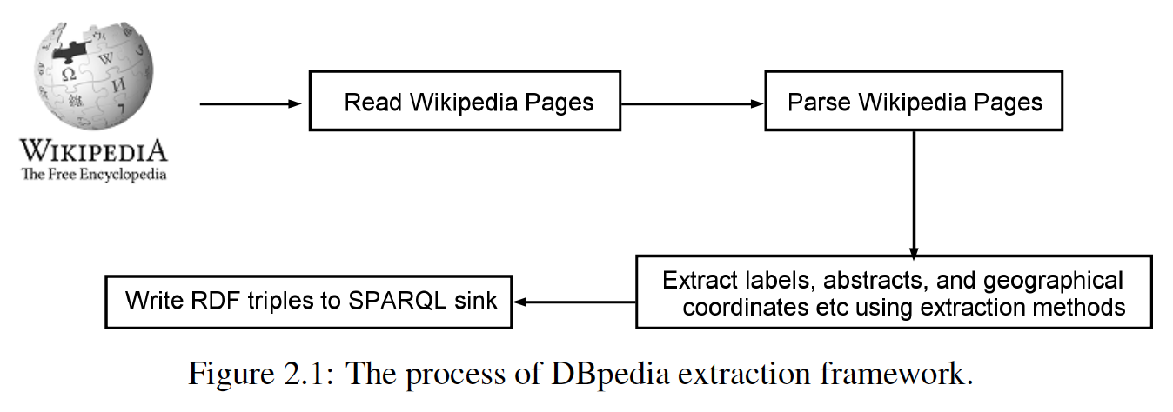
Current Status (continued)
Mapping of multiple languages
Similar example of English “Rice” with Bengali “চাল”
Structural mapping
Standard way of mapping

Slide 16
Current Status (continued)
Mapping of multiple languages
Similar example of English “Rice” with Bengali “চাল”
Structural mapping
Infoboxes acting as source for data extraction [20]
Two extraction techniques used most commonly [9]
[9] J. Lehmann, R. Isele, M. Jakob, A. Jentzsch, D. Kontokostas, P. N. Mendes, S. Hellmann, M. Morsey, P. van Kleef, S. Auer, et al., “DBpedia–a large-scale, multilingual knowledge base extracted from Wikipedia,” Semantic Web, vol. 6, no. 2, pp. 167–195, 2015.
[20] Wikipedia, “Help:Infobox— Wikipedia, the free encyclopedia.”http://en.wikipedia.org/w/index.php?title=Help%3AInfobox&oldid=719256926, 2016. [Online; accessed 04-June-2017].

Slide 17
Structural Mapping
Raw infobox extraction
Direct mapping from infobox to RDF statements
Generic heuristic based algorithm used
Data redundancy
“name” and “title” considered as different properties
Lack of classification
Data may not belong to any classes in DBpedia
Mapping-based infobox extraction
Data extraction from selected infoboxes
Need existence of mapping between Wikipedia and DBpedia
Improved quality of extracted data
Notes:
Limits the number of infobox for mapping-based extraction

Slide 18
Depiction of Entities of Different Languages
Statistics of Wikipedia
Started with English only
English still the richest [24]
290 languages integrated [24]
Only 15 languages with more than million entities [25]
Numbers falter when canonicalized data is considered [2,3]
[2] K. Katzner, The languages of the world. Routledge, 2002.
[3] J. Aitchison, Language change: progress or decay? Cambridge University Press, 2001.
[24] Wikipedia, “Wikipedia —Wikipedia, the free encyclopedia.” https://en.wikipedia.org/wiki/Wikipedia, 2018. [Online; accessed 17-April-2018].
[25] Wikipedia, “Home — Wikipedia, the free encyclopedia.” https://www.wikipedia.org/, 2018. [Online; accessed 17-April-2018].

Slide 19
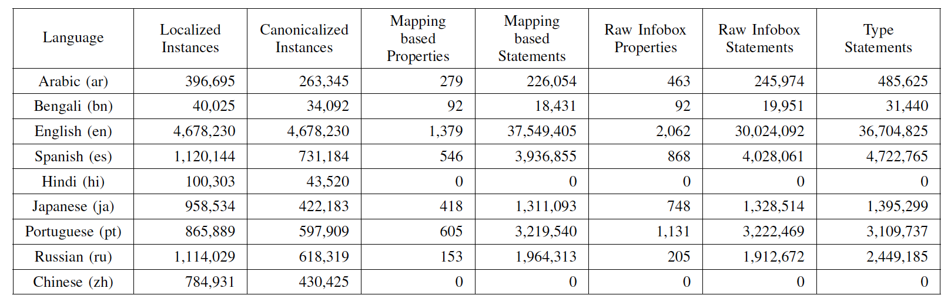
Depiction of Entities of Different Languages
Comparison among the nine most spoken languages [12], [13] with respect to the available resources in DBpedia [14].
[12] F. Giunchiglia, M. Yatskevich, P. Avesani, and P. Shvaiko, “A large scale dataset for the evaluation of ontology matching systems,” tech. rep., University of Trento, 2008.
[13] J. Euzenat, C. Meilicke, H. Stuckenschmidt, P. Shvaiko, and C. Trojahn, “Ontology alignment evaluation initiative: six years of experience,” in Journal on data semantics XV, pp. 158–192, Springer, 2011.
[14] G. Rizzo, Knowledge extraction from unstructured data and classification through distributed ontologies. PhD thesis, Politecnico di Torino, 2012.

Slide 20
Depiction of Entities of Different Languages
DBpedia [9]
Localized data set: No links or maps
Canonicalized data set: Equivalent pages in Wikipedia
URI derivation: http://dbpedia.org/resource/ [4]
Issue for localized data
Localized URIs
Multiple URIs for same entity
http://es.dbpedia.org/page/Earth/origen
English DBpedia: origin
Infobox extraction technique [17]
Mapping-based extraction: applicable for the mapped entities
Raw infobox extraction: provides jumble of references [14]
53 languages can be extracted
[4] dbpedia.org, “DBpedia 2016-04 Statistics.”http://wiki.dbpedia.org/dbpedia-2016-04-statistics. [Online; accessed 17-June-2017].
[14] G. Rizzo, Knowledge extraction from unstructured data and classification through distributed ontologies. PhD thesis, Politecnico di Torino, 2012.
[17] M. Morsey, J. Lehmann, S. Auer, C. Stadler, and S. Hellmann, “Dbpedia and the live extraction of structured data from wikipedia,” Program, vol. 46, no. 2, pp. 157–181, 2012.
Notes:
Technical details for DBpedia

Slide 21
Related Works
Live extraction of structured data
High operational cost to extract data
Concerned with data added to Wikipedia in real time
Enhances the ontology on the go [17]
Termed as DBpedia-Live
Focuses on timely synchronization
Search engine for DBpedia
Alternative of SPARQL queries
Introduction of DBpediaSearch
Allows human understandable keywords [21]
Generic search results displayed
[17] M. Morsey, J. Lehmann, S. Auer, C. Stadler, and S. Hellmann, “Dbpedia and the live extraction of structured data from wikipedia,” Program, vol. 46, no. 2, pp. 157–181, 2012.
[21] H. K. Arnaout, DBpediaSearch: an effective search engine for DBpedia. PhD thesis, American University of Beirut, 2018.

Slide 22
Related Works (continued)
Augmentation of a feature set using linked open data
Focuses on specific type of data
Reference focused on MovieTweetings
Extracted data added to current multilingual ontology [22]
The knowledge may not be structured
Matching HTML tables to DBpedia
Uses structure of programming languages
Links the knowledge in HTML tables [23]
Process can be utilized for other programming languages
[22] J. Kuchar, “Augmenting a feature set of movies using linked open data.,” in Challenge+DC@ RuleML, 2015.
[23] D. Ritze, O. Lehmberg, and C. Bizer, “Matching html tables to dbpedia,” in Proceedings of the 5th International Conference on Web Intelligence, Mining and Semantics, p. 10, ACM, 2015.

Slide 23
Analytical Summary
Lot of research to improve the process of data extraction from DBpedia
Structure of ontology is quite significant
Operational complexity to fetch data is a major challenge
All mapping techniques dependent on the multilingual ontology
Search engines and markup language mappings cover a small portion of the unstructured data
Major dependency on data sets
Performance depending on structure of the ontology and level of optimization of the data sets
Notes:
Only what we found out

Slide 24
Research Questions
Framework of ontology
Judged due to dependency on the ontology
Needs easier means of extraction
Adaptation of new features
Ontology should provide more and more features
Should be able to adapt multiple languages
Should be able to adapt to changes and new additions
Efficiency of data sets
Better data set -> easier to extract knowledge
Notes:
Imp slide: States what questions we answered in this thesis

Slide 25
Motivation
Ways to upgrade the source data set for easy adaptation lacks in existence
A precise way to identify entities without redundancy still lacks in existence

Slide 26
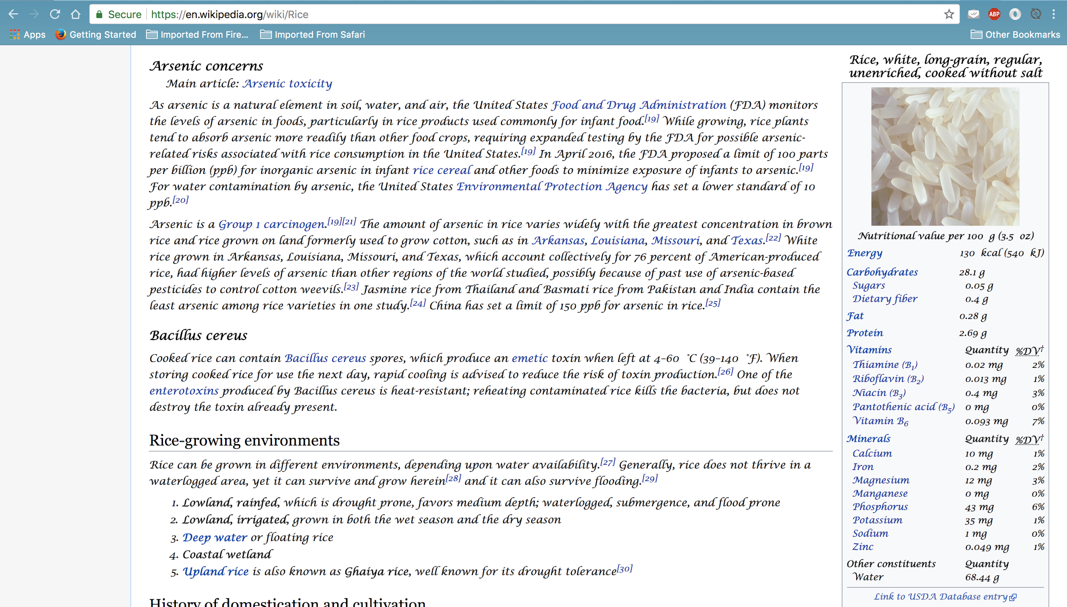
Motivation (continued)
Fig. Wikipedia page for Rice (en)

Slide 27
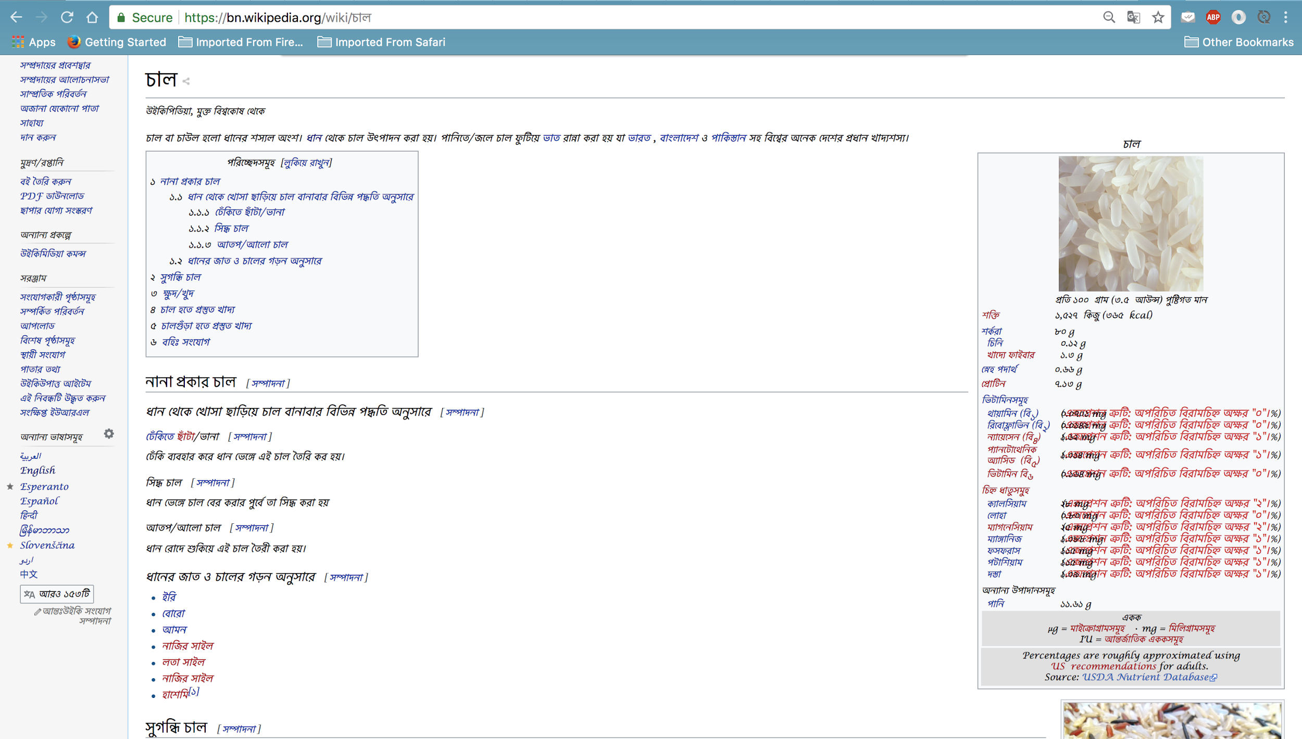
Motivation (continued)
Fig. Wikipedia page for Rice (bn)

Slide 28
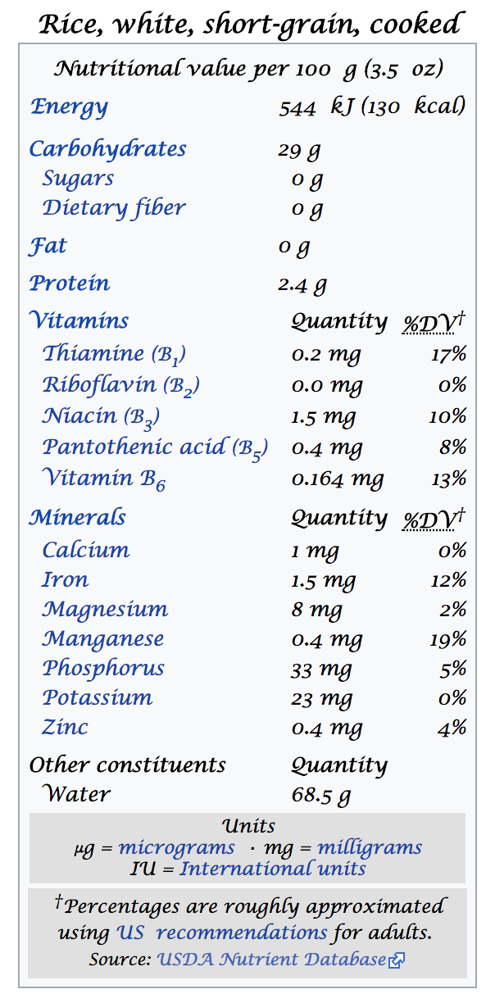
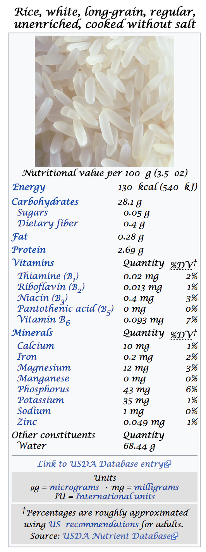
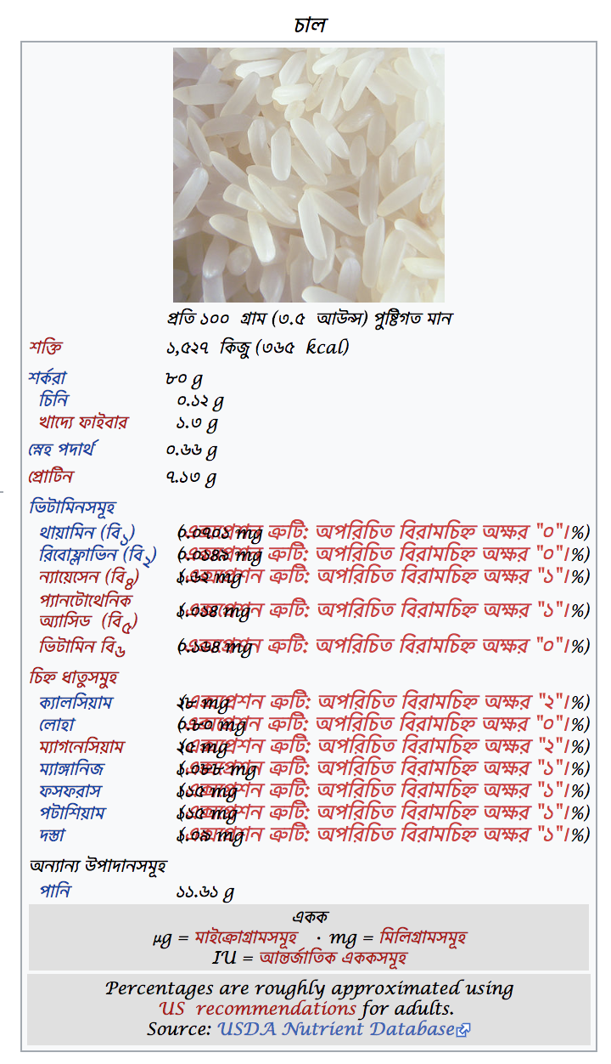
Motivation (continued)
English
Bengali

Slide 29
Motivation
Had the data sources been merged/mapped, both the pages would have been able to host similar information
Only ensuring the data sets be fetched from a single source would bring in the entire knowledge base, mapping is not mandatory
Also possible improvements in DBpedia Entity, DBpedia ChatBot, NLI-GO DBpedia, Chaudron, Sparklis etc.

Slide 30
Proposed Methodology
Separated into two hypotheses
Framework for Wikipedia entry augmentation
Published in proceedings of 19th International Conference on Computer and Information Technology (ICCIT), held at Dhaka, Bangladesh
Submerging multilingual entities
Published in proceeding of 6th International Conference on Informatics, Electronics and Vision (ICIEV), held at Hyogo, Japan

Slide 31
Framework for Wikipedia Entry Augmentation
A multilingual ontology
Dictionaries for each language
One single ontology
Enrich data set of the ontology
A mapping technique to link up words of all languages
Create URIs for each individual entity
Retrieve information for use in web content
Additional step: render web content
Simpler way for users to link up materials in their content with URIs

Slide 32
Multilingual Ontology
One highly enriched ontology
Ability to utilize infinite number of dictionaries
Separate dictionary for each individual language is considered at the moment
All existing and upcoming dictionaries can share
Consists of a set of distinct concepts, having inter-relations, denoted by a set of relations
Integration of such an ontology will augment the data set of Wikipedia

Slide 33
Multilingual Ontology Mapping
Most significant part for the augmentation of Wikipedia
Prerequisites:
Consider a technique that does not require frequent changes of the multilingual ontology
A technique is proposed, based on [8]
[8] C. T. dos Santos, P. Quaresma, and R. Vieira, “A framework for multilingual ontology mapping,” in Proceedings of the International Conference on Language Resources and Evaluation, LREC, ACM, 2008.

Slide 34
Multilingual Ontology Mapping (continued)
Consider an existing dictionary
Already integrated with multilingual ontology
Motive is to map a new dictionary
Not mapped with multilingual ontology
Finally to link up all the resources from new dictionary with URIs

Slide 35
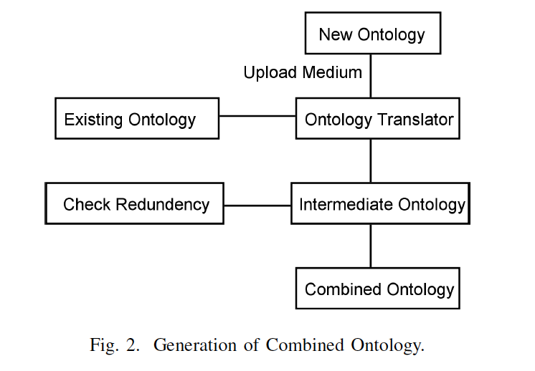
Multilingual Ontology Mapping (continued)

Slide 36
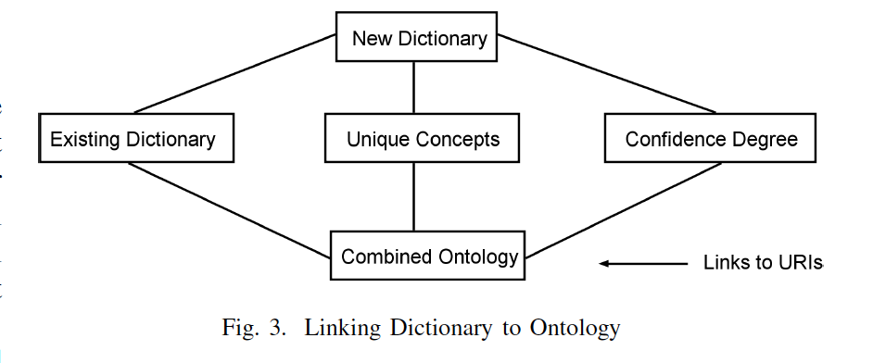
Multilingual Ontology Mapping (continued)

Slide 37

Information Retrieval
SPARQL ENDPOINT
Construct SPARQL queries directly
Textual Queries
Provide queries in Bengali with tag <BN>
Translate to English
Covert to entities
Retrieve from Named-Entity Recognition API
Form SPARQL query

Slide 38
Data Sets of the Ontology
SPARQL queries to fetch data triples
Subject-property-object format [5]
Data triples fetched for each entity
Source is DBpedia itself
Major focus: optimizing data sets
[5] L. Yu, A developer’s guide to the semantic Web. Springer Science & Business Media, 2011.

Slide 39
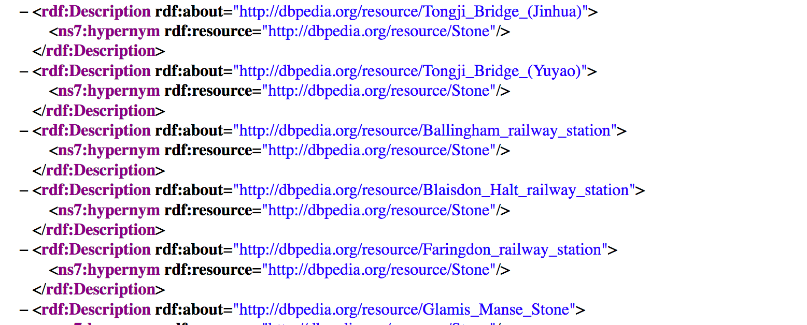
Data Sets of the Ontology
Example data set

Slide 40
Submerging Multilingual Entities
Pre-requisite
Adapt examples from two languages
English and French
Number of properties against entities in the two languages are different
The number of properties can be greater for a specific entity in either of the languages
Statements: Literals and URIs [5]
URIs: may or may not have local name
Work flow demonstrated by using: “Lune” and “Moon”
[5] L. Yu, A developer’s guide to the semantic Web. Springer Science & Business Media, 2011.

Slide 41
Submerging Multilingual Entities
Step: Input
An interface implemented in the system for user interaction
“Lune” is taken as an input
Step: Initializing data sets
“Lune” -> Translator -> “Moon”
Generate subsequent DBpedia links [5]
“Lune”: http://fr.dbpedia.org/data/Moon.rdf
“Moon”: http://dbpedia.org/data/Moon.rdf
Execute SPARQL queries
Subject-property-statement format
“lang” tag as additional data
[5] L. Yu, A developer’s guide to the semantic Web. Springer Science & Business Media, 2011.

Slide 42
Submerging Multilingual Entities
Step: Structuring data format
Save lexical data for literal statement
Property: name, statement: “Moon”
Extract local name for URI (if possible)
Property: type, statement: http://dbpedia.org/class/yago/CelestialBody109239740, local name: “CelestialBody109239740”
Save URI as statement otherwise
Property: wasDerivedFrom, statement: http://en.wikipedia.org/wiki/Moon?oldid=707145816
Assign language tag (if available)
Property: name, statement: “Moon”, lang: en

Slide 43
Submerging Multilingual Entities
Step: Additional consideration for French data set
Check if literal statement is a number
Lang: en if true
If local name is present but language tag is empty, check probable language
Highest priority: en, lang: en
Otherwise, if priority: fr is greater than zero, lang: fr
Check URLs for hint of specific language
Statement: “http://fr.dbpedia.org/…”, lang: fr
Step: Initiate sub-merging process
Populate new data set with entire English data set
All entities of English data set are mapped
Pass French data set through the set of semantic rules

Slide 44
Submerging Multilingual Entities
Step: Semantic rules
Compare property-statement-lang:fr with all property-statement-lang:en
Discard french pair for perfect match (redundant case)
Consider: label-Lune-fr
Match

Slide 45
Submerging Multilingual Entities
Step: Semantic rules
For each property-statement-lang:fr and statement -> literal
Statement (fr) -> translator -> translated_statement (en)
Compare translated_statement (en) with all statement (en)
For match, generate property (en), statement (fr), lang (fr)
Check generated pair for existence in sub-merged data set
Add if not present
Consider: title-lune-fr
Match
Exists in the sub-merged data set

Slide 46
Submerging Multilingual Entities
Step: Semantic rules
For each property-statement-lang:fr and statement -> local name of a URI
Statement (fr) -> translator -> translated_statement (en)
Compare translated_statement (en) with all statement (en)
For match, generate property (en), statement (fr), lang (fr)
Check generated pair for existence in sub-merged data set
Add if not present
Consider: wikiPage-CelestialBody109239740-fr
Added as a new triple

Slide 47
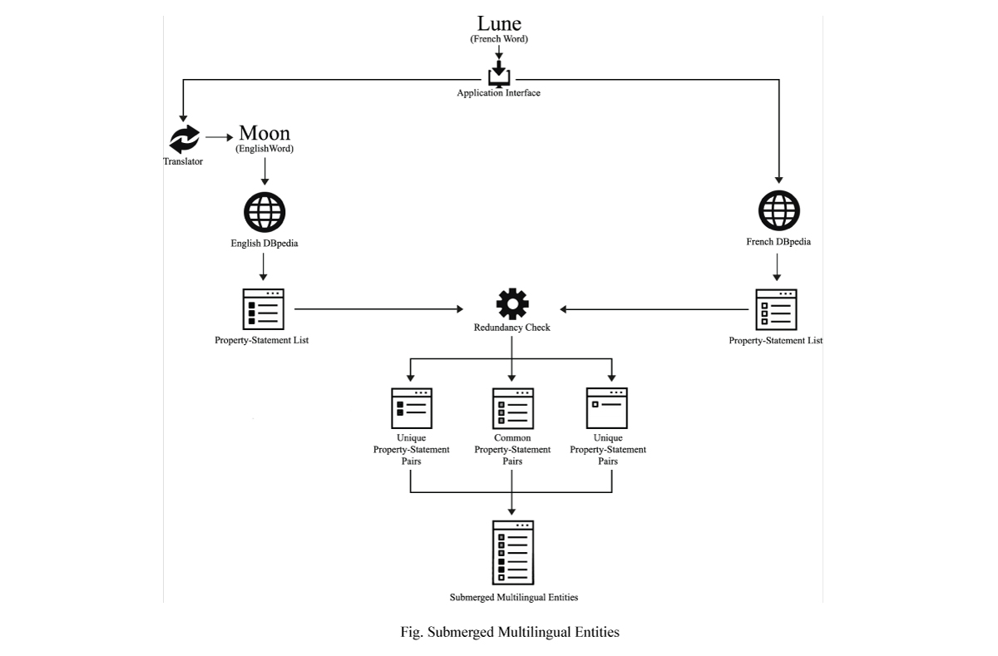
Submerging Multilingual Entities
Step: Finalize the sub-merged data set

Slide 48
Complexity Assessment
Consider label-lune (fr)
Fetched from French RDF at first level
Compared to each entry from English RDF in two level loop
For positive match, “lune” translated to “moon” in first level
Further consideration in two level loop
Statement type denoted in first level
Final decision taken in first level
Order O(n²) for two languages and each entity
For n languages: (n-1)n²
For m entities in the richer language: m x (n-1)n²

Slide 49
Finalizing New Data Set
All redundant data removed
New data set formed
English entries
Unique French entries
Referenced through the identifier of the subject
Adaptable for a single ontology

Slide 50
Summary
The current multilingual ontology is modified to include multiple data sets.
The extraction techniques are to be implemented to ensure that the knowledge base is properly mapped and the extracting technique agrees with the mapping.
One rich and mapped language and another language, which is comparatively new, are to be considered and one specific word is selected and translated for adaptation in both languages.
The words are mapped with DBpedia following specific rules to form URLs.
Notes:
Elaborate at this point. State what we accomplished.

Slide 51
Summary (continued)
The knowledge base for both the words are extracted using standard extraction techniques.
The data sets are prepared from the knowledge bases so that they are compatible for further processing.
The set of semantic rules are implemented on the processed data sets.
The final and augmented data set is created by the resulting knowledge base obtained after implementing the set of semantic rules.

Slide 52
Experimental Implementation
Competency of the system
The proposed framework [11] yields best result for implementation of the system [16]
All extraction techniques improved by implementation of [16]
Dependency
Dictionary to ontology parser (for framework): OntoLearn, Text2Onto, SPRAT etc.
Translation Engine (Google Translate API)
Existing multilingual ontology [8]
JDOM library for XML generation
[11] M. T. M. Ankon, S. N. Tumpa, and M. M. Ali, “A multilingual ontology based framework for wikipedia entry augmentation,” in Computer and Information Technology (ICCIT), 2016 19th International Conference on, pp. 541–545, IEEE, 2016.
[16] M. T. M. Ankon and M. M. Ali, “Wikipedia entry augmentation by sub-merging entities based on multilingual ontology,” in Informatics, Electronics and Vision & 2017 7th International Symposium in Computational Medical and Health Technology (ICIEV-ISCMHT), 2017 6th International Conference on, pp. 1–6, IEEE, 2017.

Slide 53
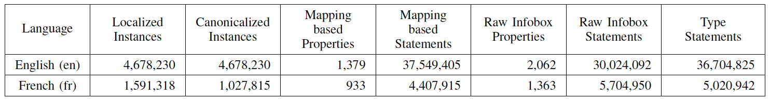
Experimental Implementation
Selection of language and translation
Comparison between English and French
Google translate API

Slide 54
Experimental Implementation (continued)
Populating data sets
SPARQL queries to fetch existing data
Processing data sets
Run through all the rules to prepare the data for final consideration
Application of semantic rules
Conditional application on each triple of the French data set

Slide 55
Experimental Implementation (continued)
Submerging data sets
Linear traversing of the two data sets
Preparing export file
Implementation of Java library, JDOM
Generate XML files
Data in triple format

Slide 56
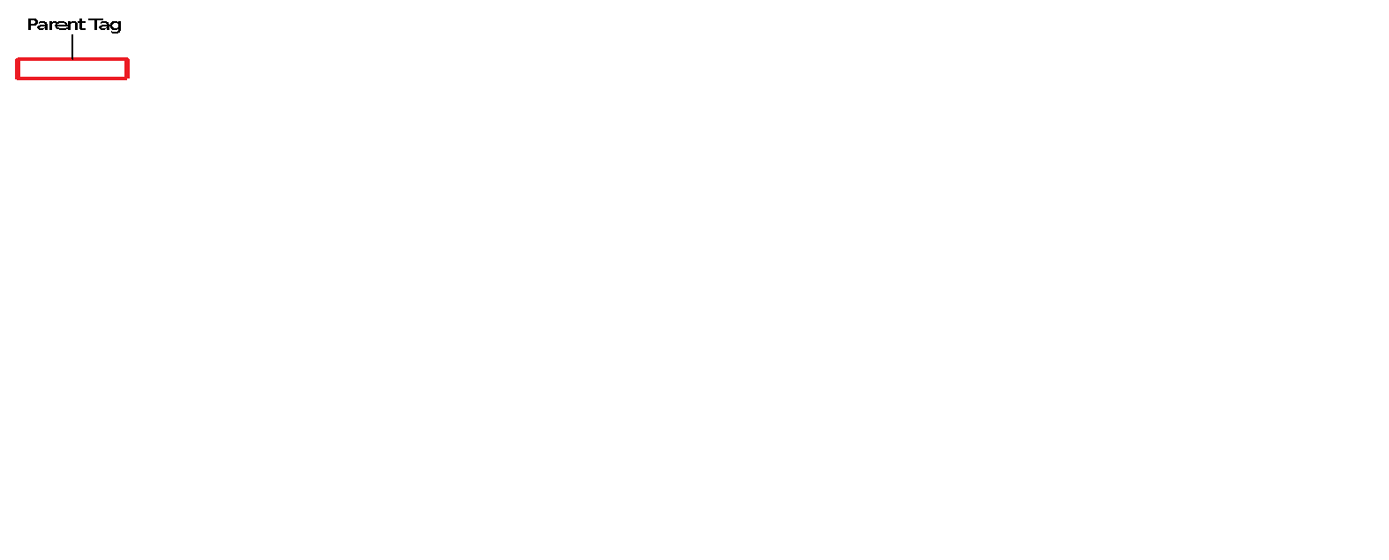
Experimental Implementation (continued)
Export file

Slide 57
Experimental Implementation (continued)
Export file

Slide 58
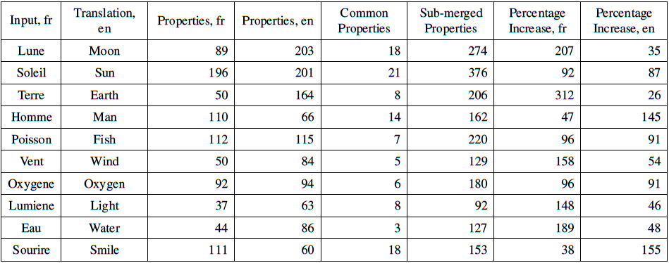
Experimental Result
Experimental results obtained by implementing the process of sub-merging multilingual entities in case of French
language.

Slide 59
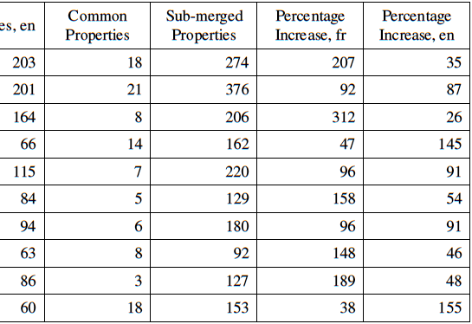
Experimental Result
100% possibility of the sub-merged data set being richer than any individual data set

Slide 60
Performance Metrics
Point of Consideration | Attainment
Number of overall language consideration | Infinite
Limit on number of data sources for consideration | None
Consideration of possible data sets | Both existing and non-existing
Percentage of cases improved | 100%
Cases with redundant data | 0
Proposed metrics generated basing on the result obtained from sub-merged data sets (multiple cases of English and French)
Each generated XML file was checked for validation through online validators https://www.xmlvalidation.com/index.php and found to be accurate

Slide 61
Experimental Results
Integration of two languages result as much
Further usage of the system with other language will contribute in similar manner
Sub-merging entities will augment the data set of DBpedia exponentially
New data set will be either equal to or greater than either of the two individual data set

Slide 62
Compendium of Attainments
Ontology able to adapt infinite number of languages
Ontology can be mapped with innumerous data sources
Submerging technique able to map with existing and non-existing DBpedia
Guaranteed improvement on application of submerging technique

Slide 63
Compendium of Attainments
Well justified set of rules applied
Set of rules to remove all major issues that may arise during data set optimization
Generation of adaptable export files

Slide 64
Publications from This Research
Research work published in 19th International Conference on Computer and Information Technology (ICCIT), 2016
Title: A multilingual ontology based framework for Wikipedia entry augmentation [11]
Research published in proceedings of 6th International Conference on Informatics, Electronics & Vision, 2017
Title: Wikipedia Entry Augmentation by Sub-merging Entities Based on Multilingual Ontology [16]
Selected as one of the finalists for best paper
[11] M. T. M. Ankon, S. N. Tumpa, and M. M. Ali, “A multilingual ontology based framework for wikipedia entry augmentation,” in Computer and Information Technology (ICCIT), 2016 19th International Conference on, pp. 541–545, IEEE, 2016.
[16] M. T. M. Ankon and M. M. Ali, “Wikipedia entry augmentation by sub-merging entities based on multilingual ontology,” in Informatics, Electronics and Vision & 2017 7th International Symposium in Computational Medical and Health Technology (ICIEV-ISCMHT), 2017 6th International Conference on, pp. 1–6, IEEE, 2017.

Slide 65
Conclusion
Integration of new languages
Generated data set either equal to or rich than existing ones
Merges two languages at a time
Opportunity to merge infinite languages at a time
Scope for Bengali DBpedia
Only URL of non-existing DBpedia required
Executing system with English and non-existent data set
New language initialized with entire knowledge base of English
Gateway to many more
Fail proof system
All non-existing DBpedia can be brought into existence

Slide 66
THANK YOU

Slide 67
ANY QUERY?

